Slide 1
Generating noisy speech data from clean data in the frequency domain using Deep Learning Methods
Week – 13
Name: Shashank Shirol
University: Manipal Institute of Technology
Duration of the presentation: ~10 mins.

Slide 2
Tasks to be completed:
Modify CUT code to incorporate an amplitude attenuation test:
Implement as a command-line option that can be activated during run-time
Scales the waveform by a certain % before generation and applies correction before reconstruction.
To train CUT with paired samples to determine if it learns better mapping:
Modify the data-loader to return paired examples instead of randomized selection from domain A and domain B
Note: Since using the g726 codec proved helpful in improving the results, all setups now use it by default.

Slide 3
Incorporating an amplitude attenuation test (I):
Implemented a command-line option that facilitates the amplitude modification, and can be activated at run-time during the generation process.
The command-line option takes a float to scale the amplitude to a certain percent before generation begins.
The value used is retained and used again for correction during reconstruction of audio signals.
The results are good – the model doesn’t blow up when we try to generate with modified amplitudes in comparison to the amplitudes used for training
The outputs and LSD scores for both – attenuated and normal generation is displayed on the next slide

Slide 4

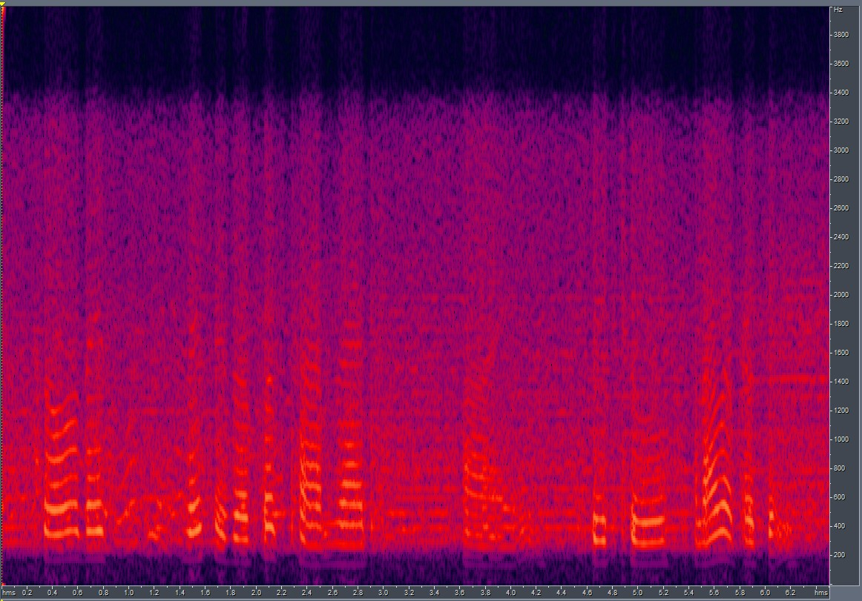
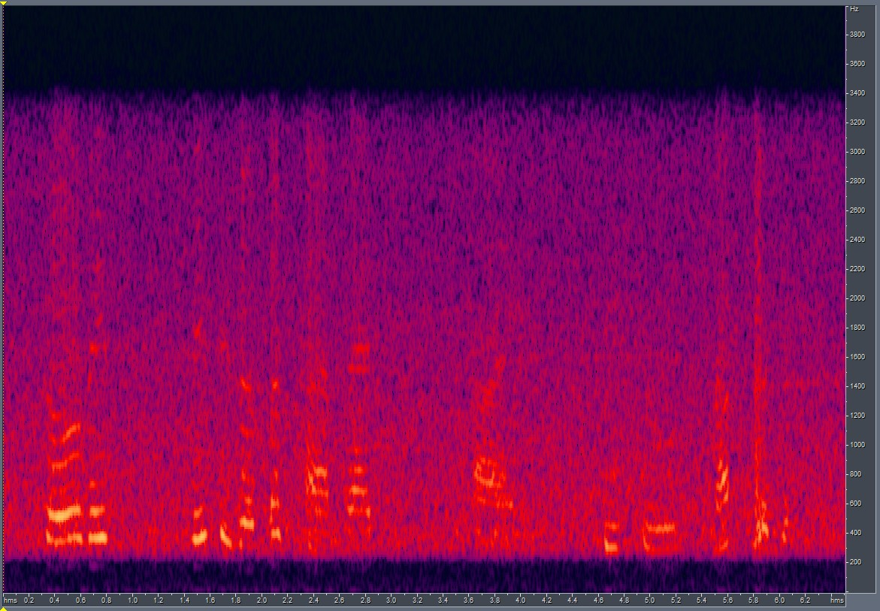

Incorporating an amplitude attenuation test (II):
LSD score between sample with 90% attenuation and Ground Truth:
LSD = 6.059569
LSD score between sample with no attenuation and Ground Truth:
LSD = 6.059470
90% atten
GT
No atten

Slide 5
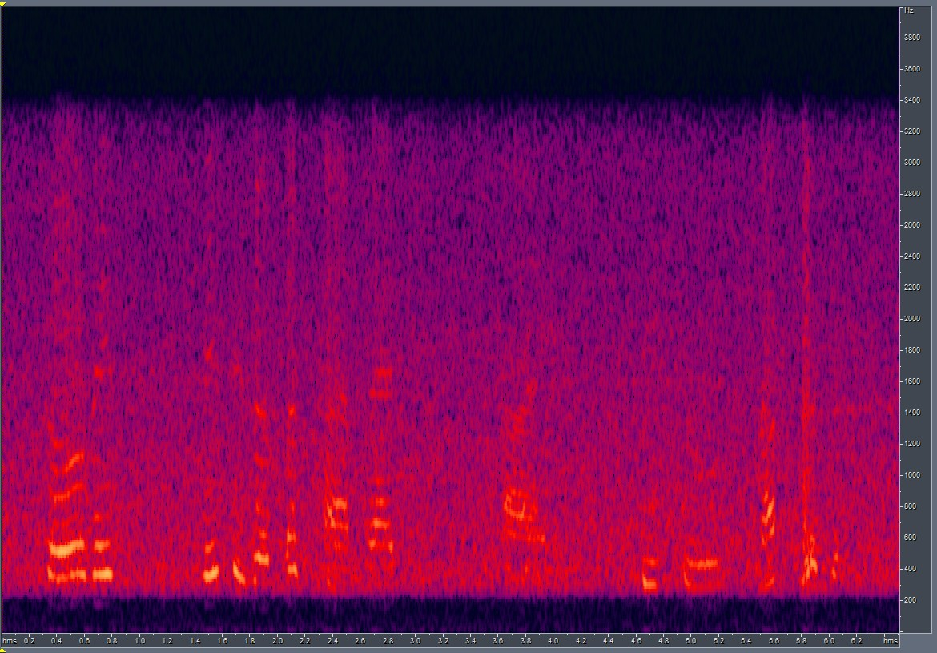
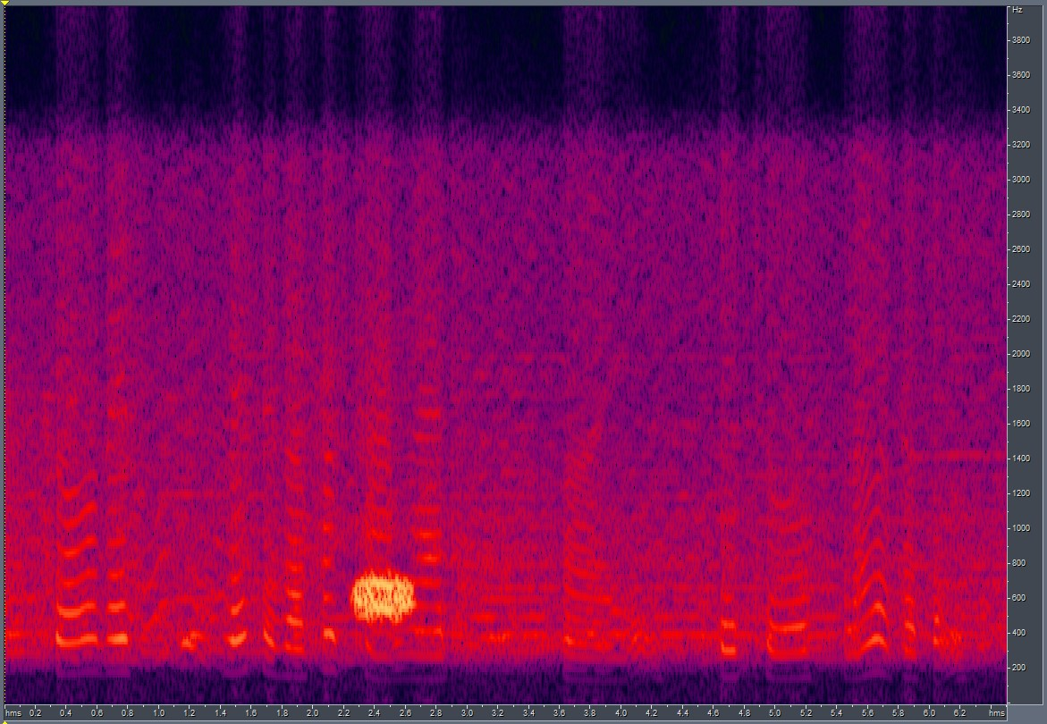
Training CUT with paired samples and generating with new random samples:
Under this, I modified the CUT data-loader that is used to load data during training. I wrote a custom loader that loaded paired samples from domain A and domain B.
This is again controlled using a run-time flag which can be switched on and off based on experimental requirements.
The results improved marginally – LSD drops from 6.059 to 5.867
GT
Output

Slide 6
End.

